Slide 1

Short Course Material
Introduction to Full-Stack JavaScript Framework

Slide 2
Mobile Application with React Native

Slide 3
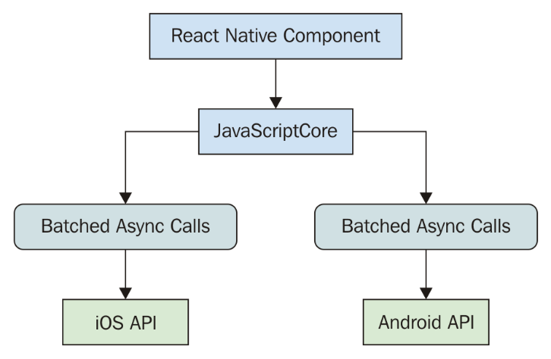

React Native
Created by Facebook for developing mobile applications
Integration with React which suitable for UI development
Capable of calling underlying mobile API

Slide 4
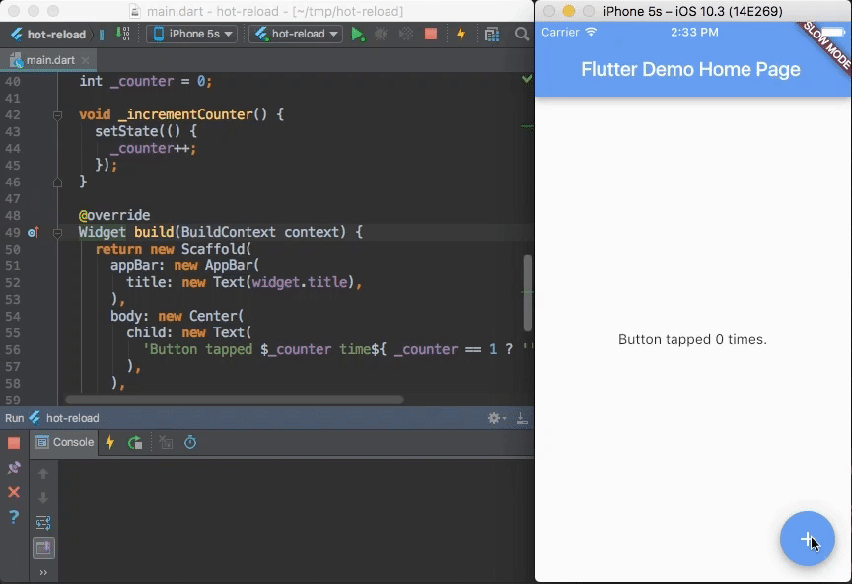
React Native - Features
Hot reload
Single JavaScript codebase with native code rendering
Support OTA updates for non-native bundles
Tons of community supported / commercial plugins

Slide 5
React Native
Creating a React Native (Typescript) project
Start Application by
npx react-native init MyProject --template react-native-template-typescript
npm run start
npm run android OR npm run ios

Slide 6
React Native
npm run start
npm run android
npm run ios
React Native app is a compiled app that is running some JavaScript.
A packager, Metro is used to bundle and compile your application
Installs RN Core and JS virtual machine on the mobile device

Slide 7
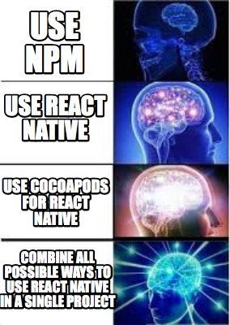
React Native – Tools comparison
React native CLI
Easy to integrate native modules
Full control over build process
Complicated setup process
Basic built-in library
EXPO
Support Web development out of the box
Plenty of built-in libraries
Certain native modules requires EXPO to be removed

Slide 8

React Native – Getting Started
import React from 'react';
import { StyleSheet, SafeAreaView,Text, View } from 'react-native';
const App = () => {
return (
<SafeAreaView style={styles.container}>
<View>
<Text>Hello world</Text>
</View>
</SafeAreaView>
);
}
export default App
const styles = StyleSheet.create({
container: {
flex: 1,
alignItems: 'center',
justifyContent: 'center',
},
});
React Component
Styling

Slide 9
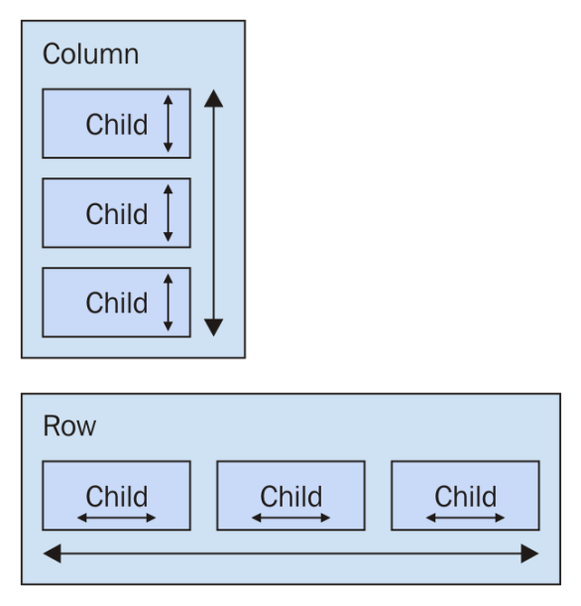
React Native - Layout
Recommended layout model – Flexbox
`flex` will define how components fills over available spaces
`flexDirection` defines the layout direction.
const styles = StyleSheet.create({
container: {
flex: 1,
alignItems: 'center',
justifyContent: 'center',
},
content: {
flex: 1,
flexDirection: 'column'
}
});

Slide 10
React Native - Components
<View> - Basic React Native container
<Text> - Basic React Native text view
<FlatList> - Generate List View
<VirtualizedList> - List view with lazy loading support
<TextInput> - User Input
<Modal> - Popup modal dialog
etc …
https://reactnative.dev/docs/components-and-apis

Slide 11

React Native - Navigation
Tab navigator provides tab-based navigation
Other navigation components can be found: https://reactnavigation.org/docs/drawer-based-navigation
npm i @react-navigation/bottom-tabs

Slide 12
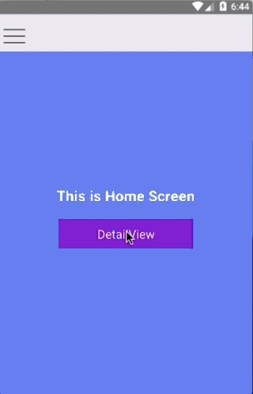
React Native - Navigation
Stack navigator provides methods for your app to transition between screens and manage navigation history
Other navigation components can be found: https://reactnavigation.org/docs/drawer-based-navigation
npm i @react-navigation/stack

Slide 13
React Native – Navigation Router
`navigation` props used for routing
Can be used to pass additional data
Route
Parameters
<Button
title="Details"
onPress={() => navigation.navigate("Details", { title: "Details Page" })}
/>

Slide 14
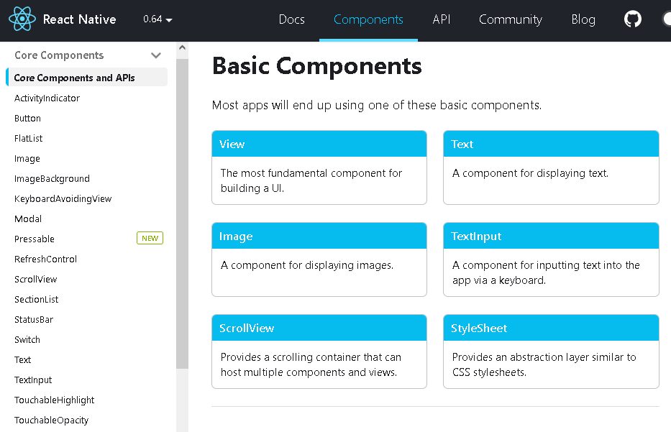
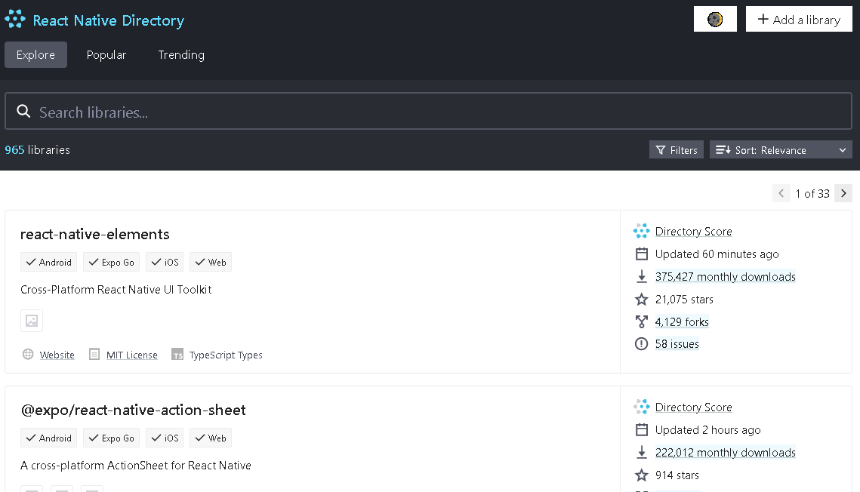
React Native – Components
https://reactnative.dev/docs/components-and-apis
https://github.com/react-native-community/
https://reactnative.directory/
https://reactnativeelements.com/

Slide 15
React Native
DEMO
P6

Slide 16
React Native - Networking
React Native supports the FETCH API
Non-SSL request are blocked by default
Android- set `usesCleartextTraffic` in manifest
IOS – add Transport Security exception
fetch('http://localhost:3000/basket/1', {
method: 'POST',
headers: {
Accept: 'application/json',
'Content-Type': 'application/json'
},
body: JSON.stringify({
productId: 1,
quantity: 10
})
});

Slide 17
React Native – Embedded Database
SQLite
Actively maintained and developed
Embedded relational database
Support SQL queries
MongoDB Realm
Mongodb’s embedded database equivalent
Non-relational
Supports most MongoDB operations
Fairly new
Supports out-of-the box synchronization (SaSS)

Slide 18
React Native – MongoDB Realm
MongoDB Realm process flow
Define Schema
Create/Open Realm with schema
const BookSchema = {
name: "books",
properties: {
_id : "objectId",
name: "string",
path: "string",
content: "string"
},
primaryKey: "_id"
}
const realm = await Realm.open({
schema: [BookSchema,UserSchema],
});

Slide 19
React Native – MongoDB Realm
MongoDB Realm supports
Similar CRUB operations as MongoDB
.query
.create (upsert)
.delete
Limited Types ( bool, int , double, Decimal128, string date, data, objectId)
Live Update ( Listener to document )
Realm Sync ( Premium feature )

Slide 20
React Native – Native modules
NativeModule system exposes instances of Java/Objective-C/C++ classes to JavaScript as objects
Some modules are available via npm packages:
Camera (react-native-camera)
Bluetooth (react-native-ble-plx)
Geolocation (react-native-location)
More packages can be found react-native-community

Slide 21
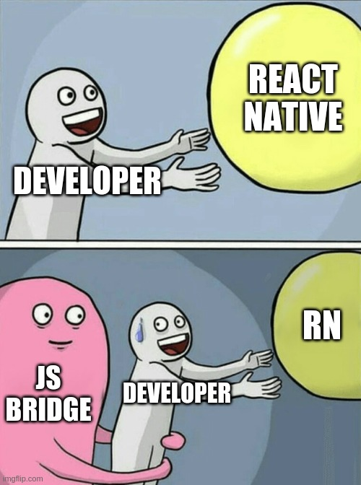
React Native – Native modules
NativeModule system exposes instances of Java/Objective-C/C++ classes to JavaScript as objects
More packages can be found react-native-community
If it doesn’t exist, or existing library is broken. You may have to develop it

Slide 22
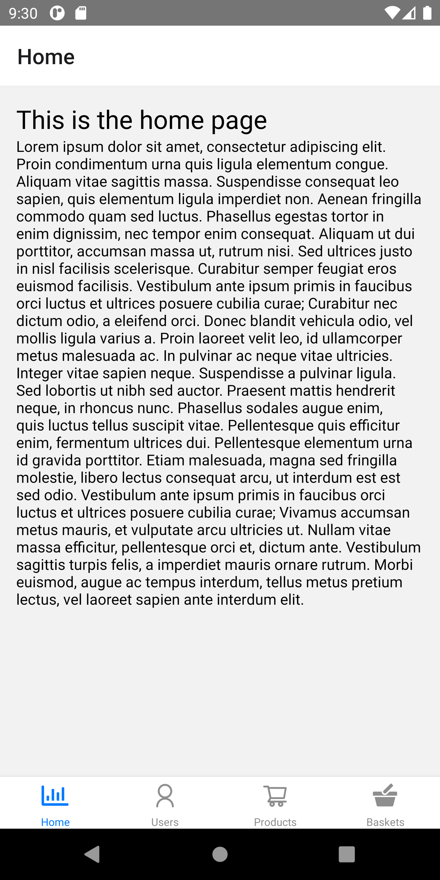
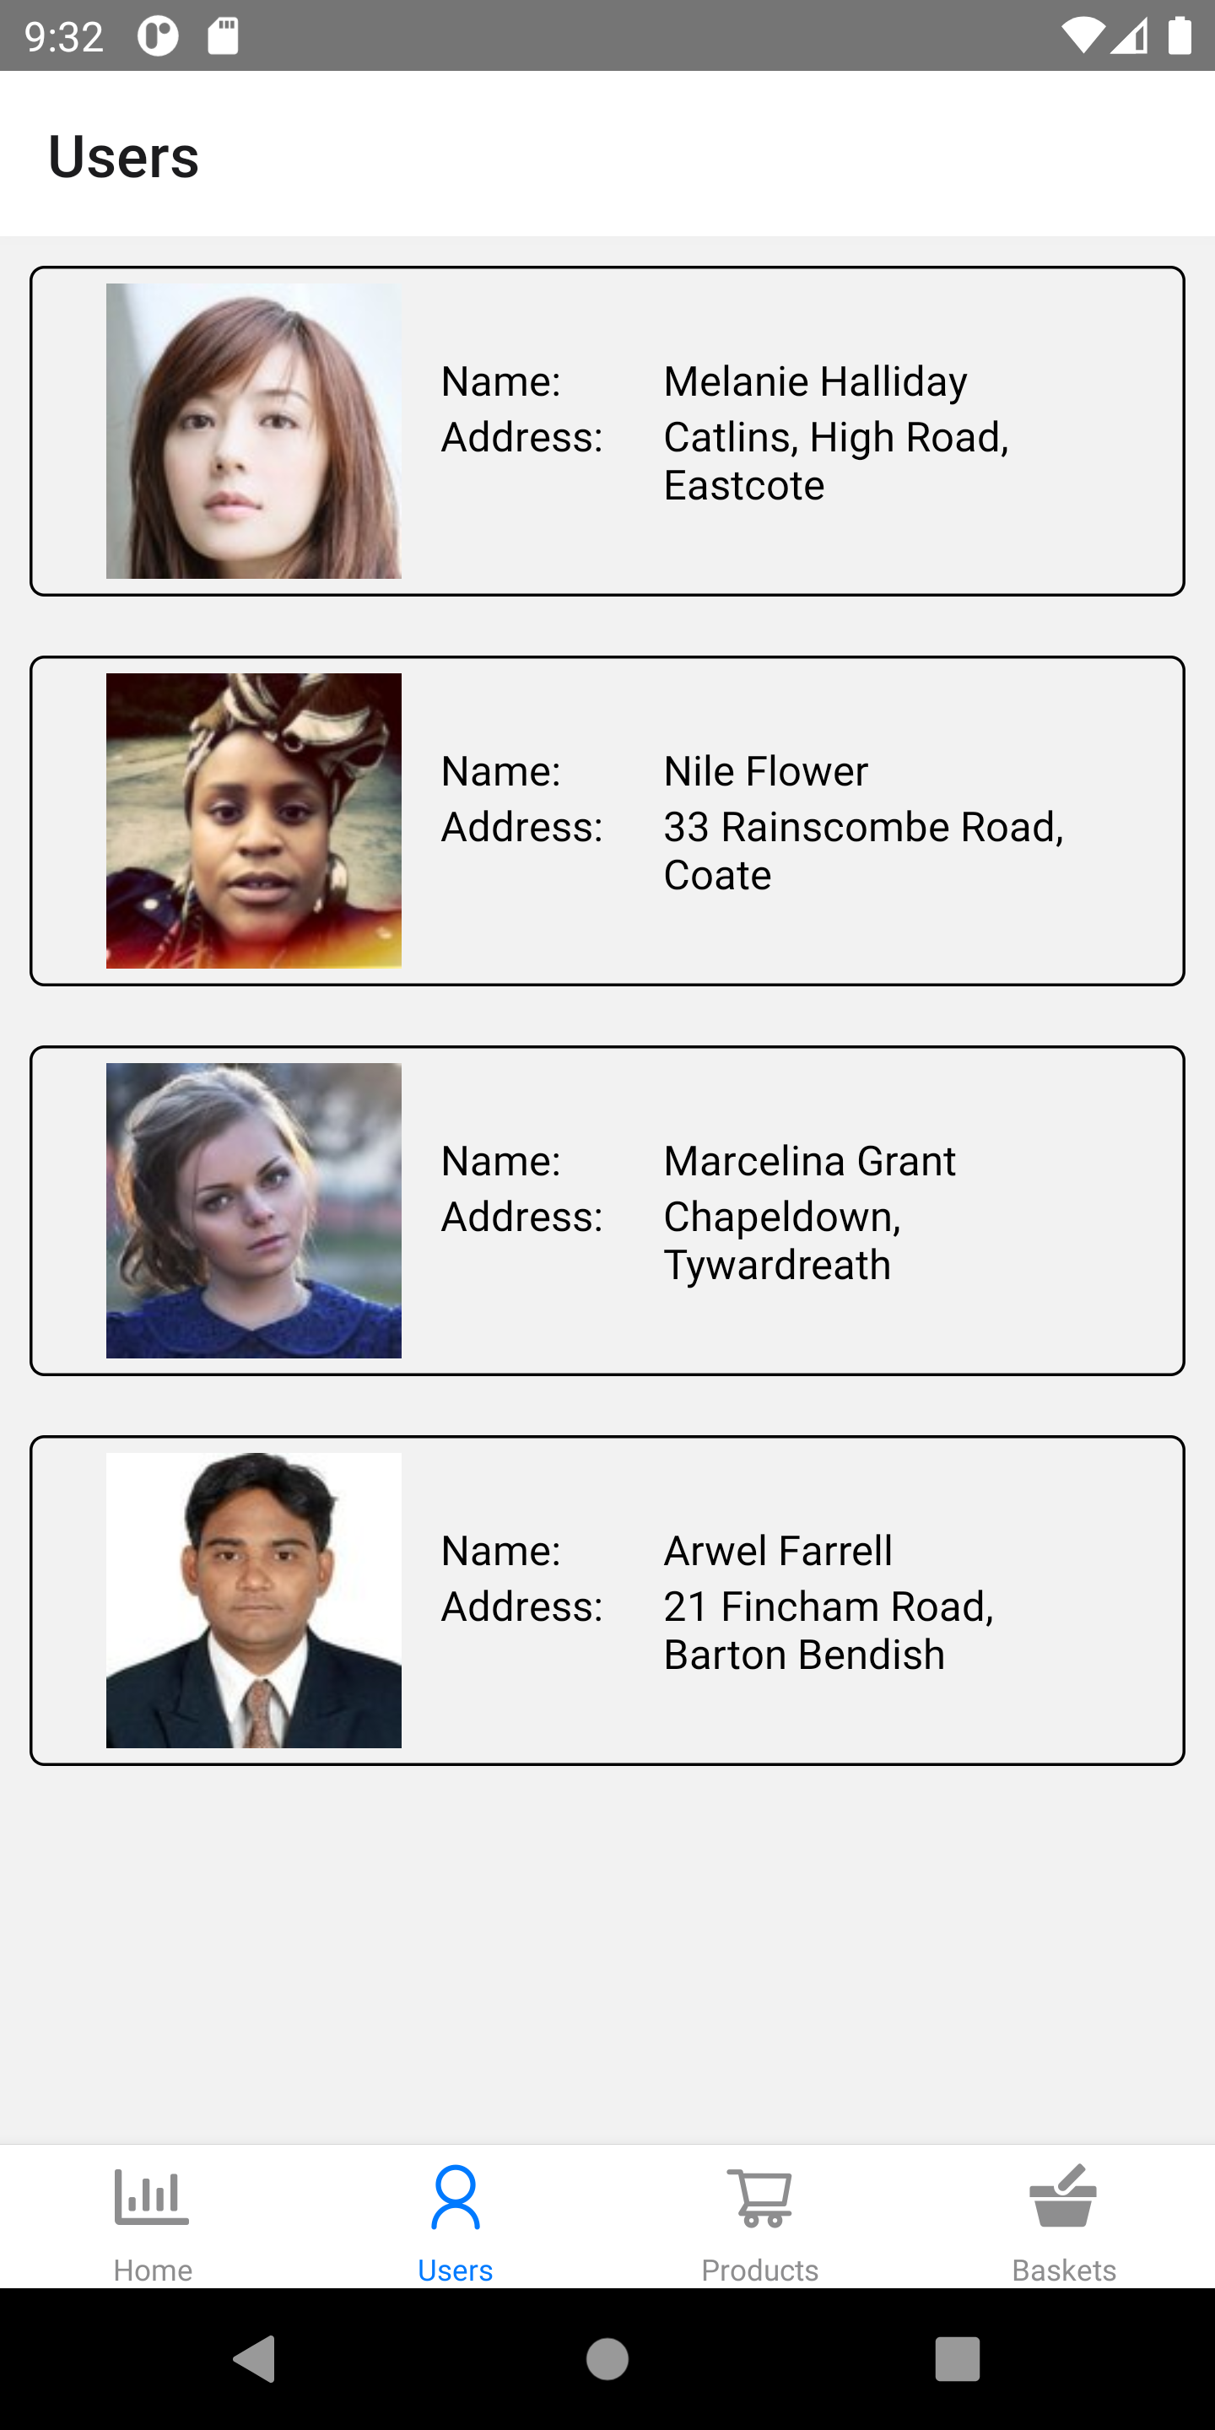
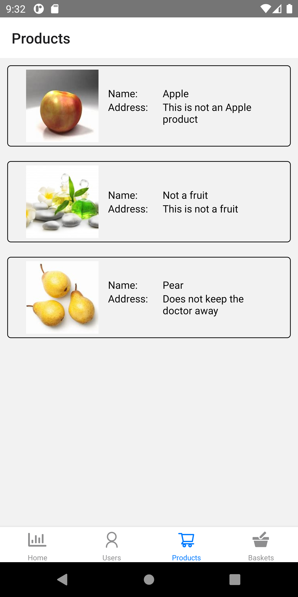
React Native
DEMO
P7

Slide 23
Thank You

